Slide 1

What is Machine Learning (ML)
ML algorithms enable the computers to learn from data,
by themselves, without being explicitly programmed.

Slide 2
Types of ML
Supervised learning
Unsupervised learning
Semi-supervised learning
Active learning
Reinforcement learning

Slide 3
Supervised learning
The goal is to use input data (x)
to predict the output variables (Y)
Output variable, (Y), target, label
This target value is obtained by someone manually labelling the data
Labelled data
Training of the model is being “supervised” and “directed”, since we know the labels of the examples

Slide 4
Types of Supervised learning
Classification
A classification problem is when the output variable is a category, such as:
“red” or “blue”
“disease” or “no disease”
“True” or “False”
Regression
A regression problem is when the output variable is a number, such as:
“dollars”
“weight”
“movie score”

Slide 5
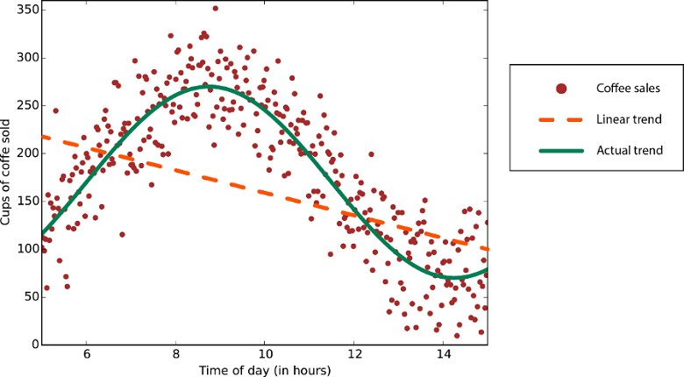
Regression – coffee sales

Slide 6
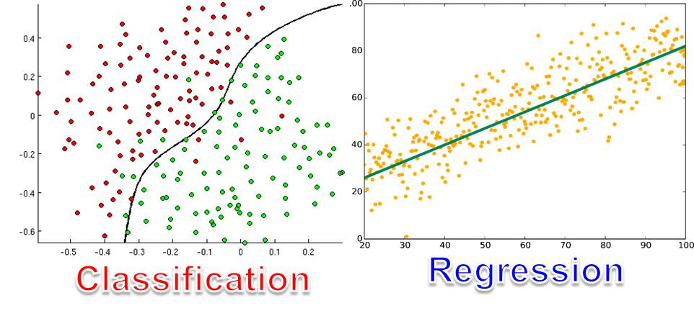

Slide 7
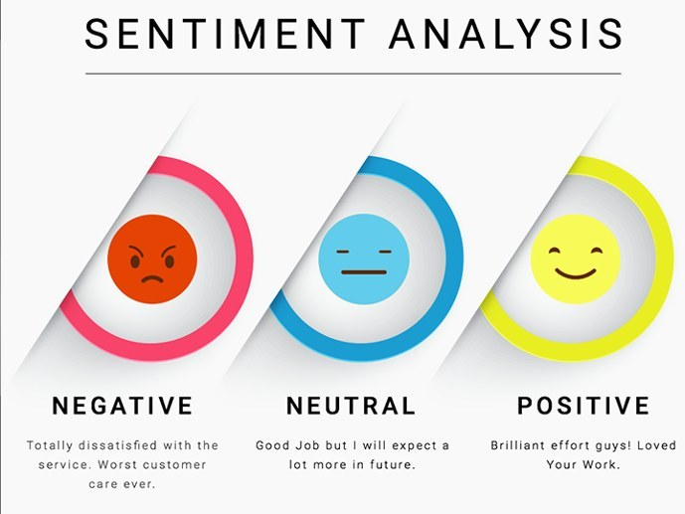
Classification - Text sentiment analysis

Slide 8
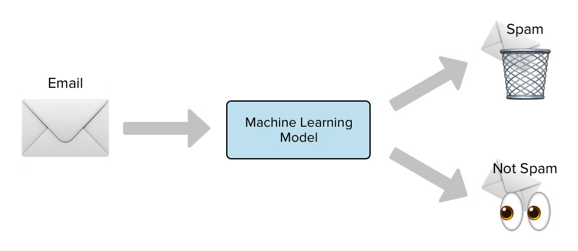
Classification – email filtering

Slide 9
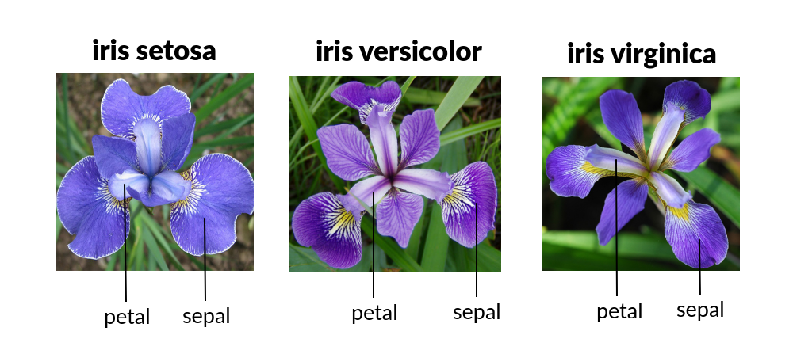
Classification – flower type

Slide 10
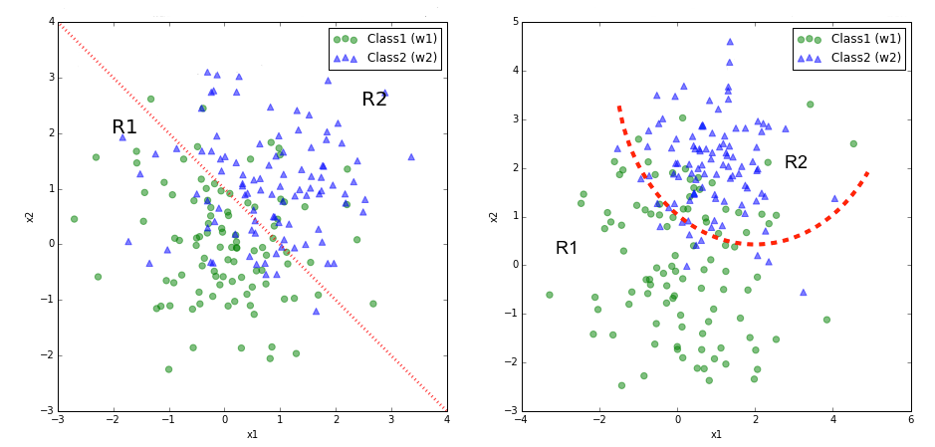
Classification

Slide 11
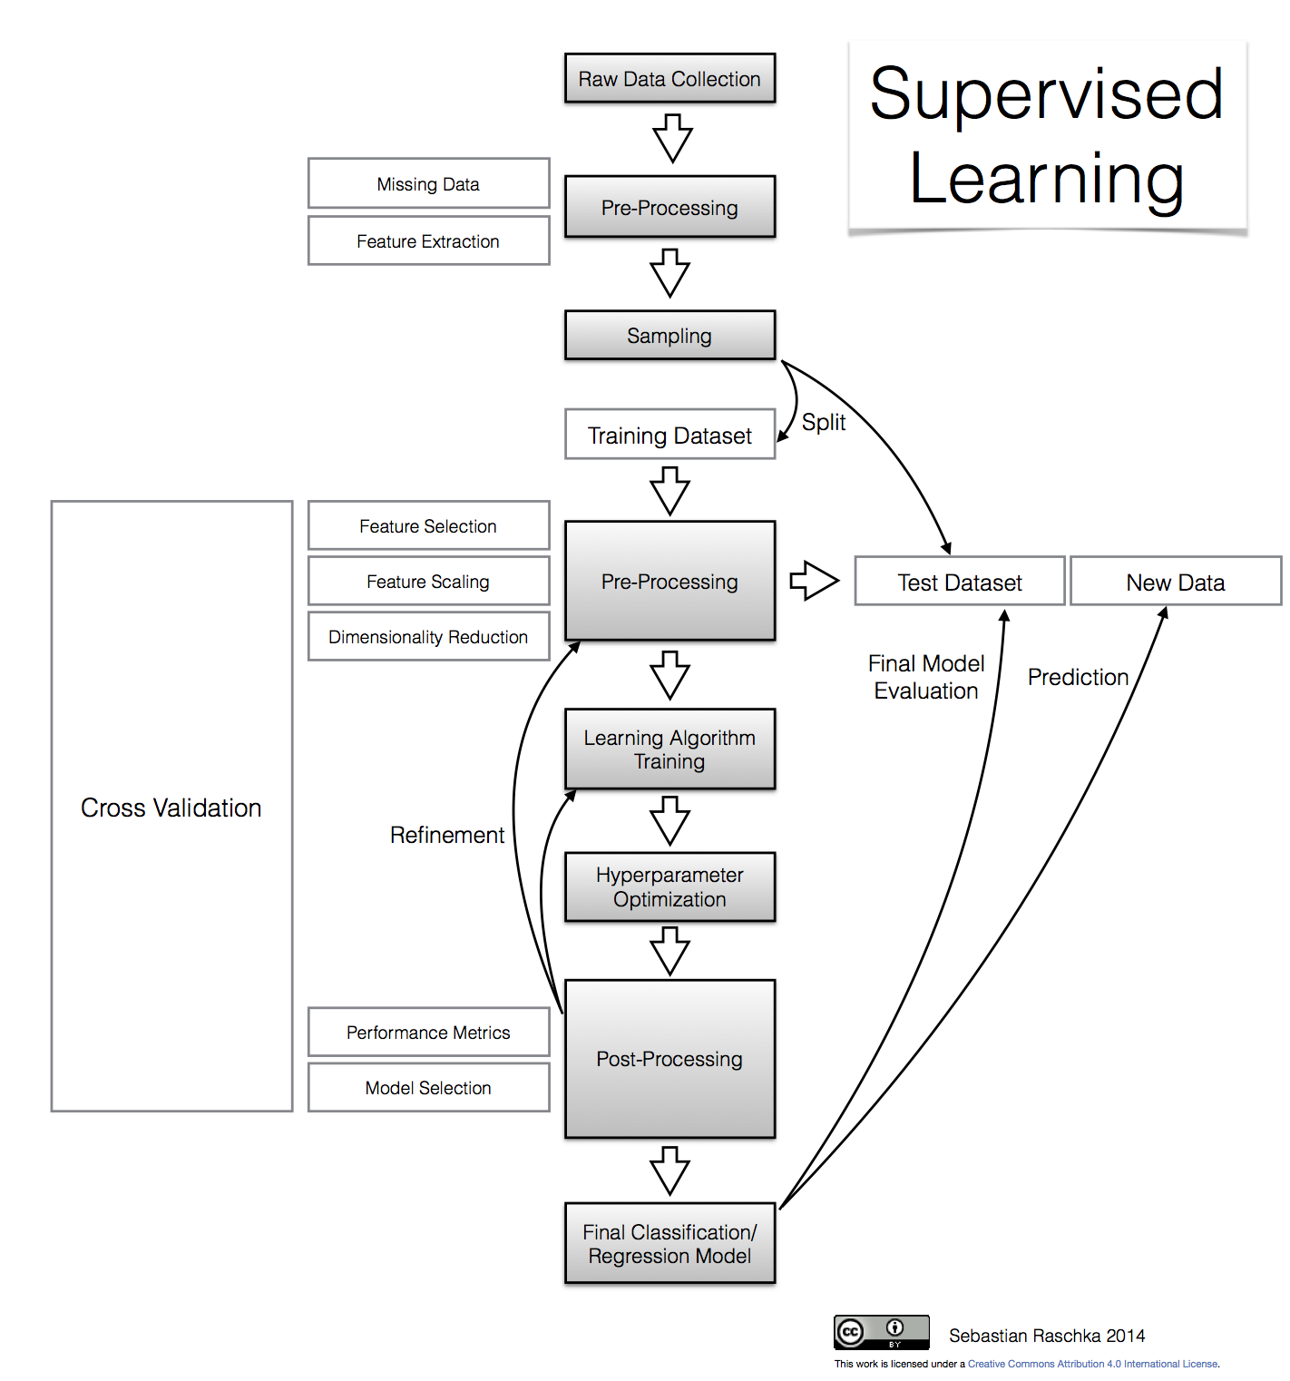

Slide 12
Unsupervised learning
The goal is to use input data (x)
to find similarities in the data.
Unlabelled data, uncategorized
The result is creation of labels for the unlabelled data.
Un-labelled data

Slide 13
Types of unsupervised learning
Clustering
A clustering problem is where you want to discover the inherent groupings in the data, such as:
grouping customers by purchasing behaviour,
groping images together to determine commonalities
Association
An association rule learning problem is where you want to discover rules that describe large portions of your data, such as:
people buying X also tend to buy Y

Slide 14
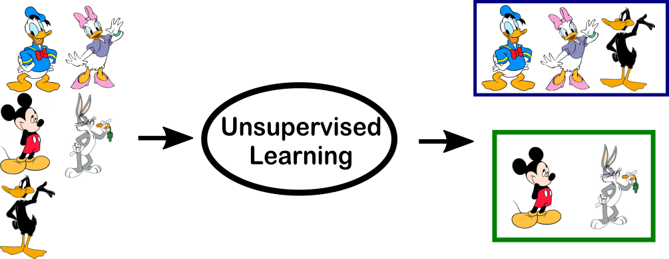
EXAMPLE – group similar photos

Slide 15
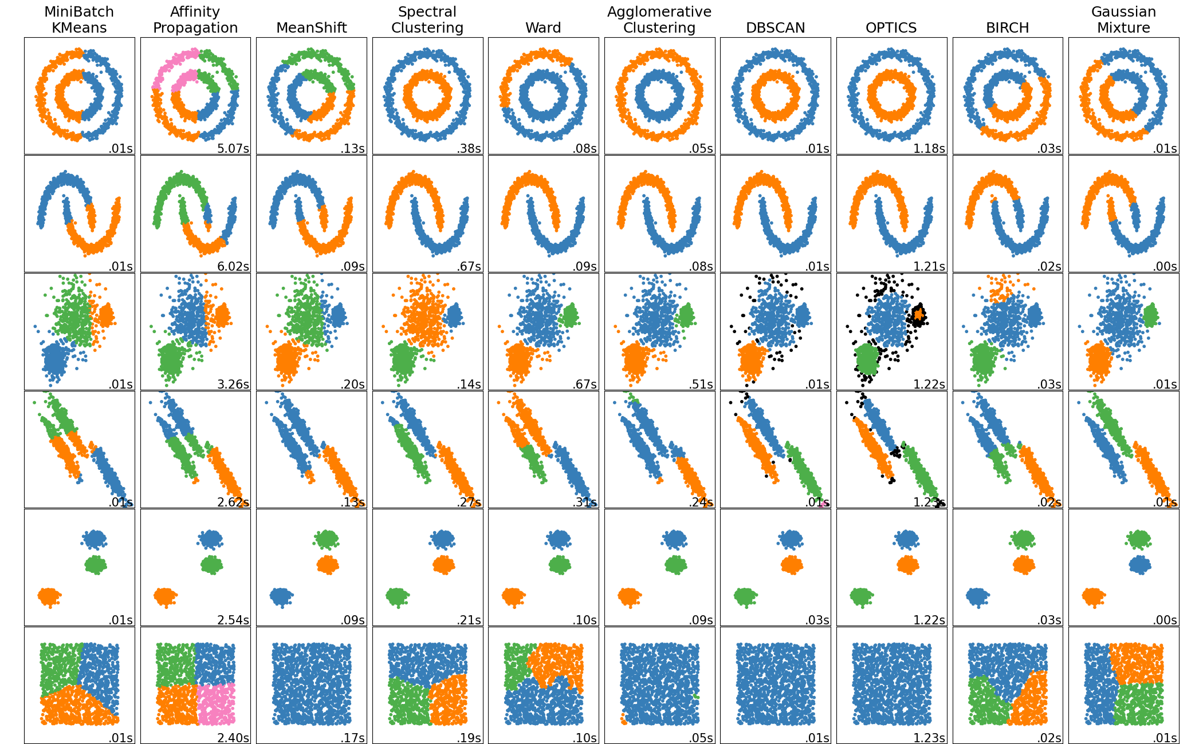

Slide 16
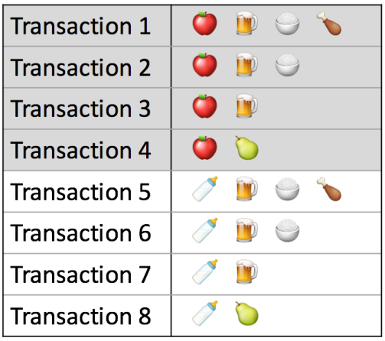
Association
Given what does customer already has in the basket, what are they likely to buy next?
Make recommendations based on this data.

Slide 17
Semi-supervised learning
The goal is to use VERY SMALL NUMBER of input data (x)
to predict the output variables (Y)
During the model’s training, it makes use of both labelled and unlabelled data.
Labelled data

Slide 18
Active learning
System is designed so that it asks the user to label small amount of unlabelled data.
Instead of doing at random, it is selected in a way such that it provides the highest impact on the model’s ability to learn.
Labelled data
Extension of semi-supervised learning

Slide 19
Reinforcement learning
Model is presented with a bunch of data and is left alone to decide what to make of it.
The only input model requires is a “learning function” which determines its behavior.
Unlabelled data

Slide 20
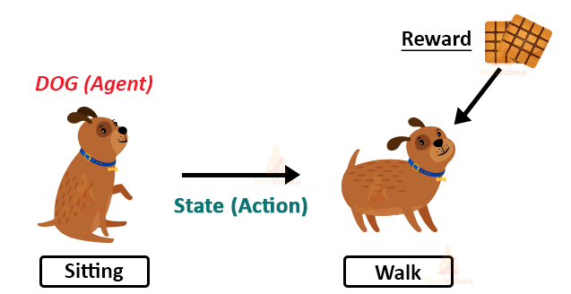

Slide 21
RECAP

Slide 22
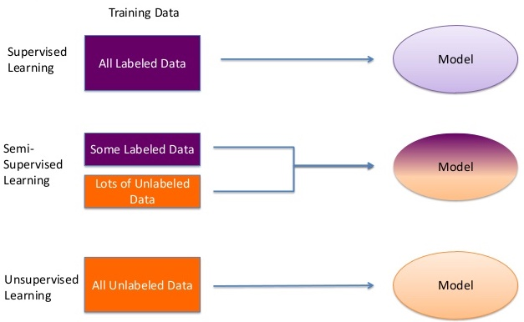

Slide 23
Supervised learning
Predictive Model
Regression – numbers
Classification – categories
Labelled data
Common Algorithms
Nearest Neighbour
Naive Bayes
Decision Trees
Linear Regression
Support Vector Machines (SVM)
Neural Networks

Slide 24
Unsupervised learning
Descriptive Model
Clustering
Association
Unlabelled data
Common Algorithms
K means
DBSCAN
Association rules

Slide 25
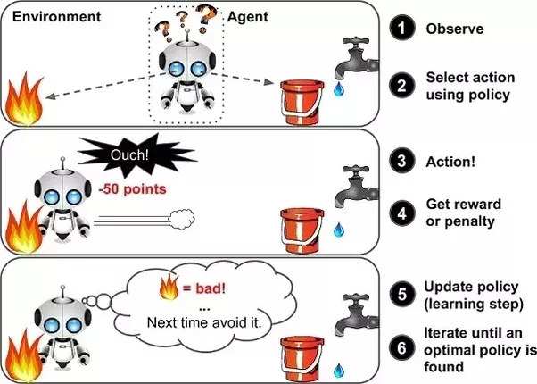
Reinforcement learning

